Slide 1
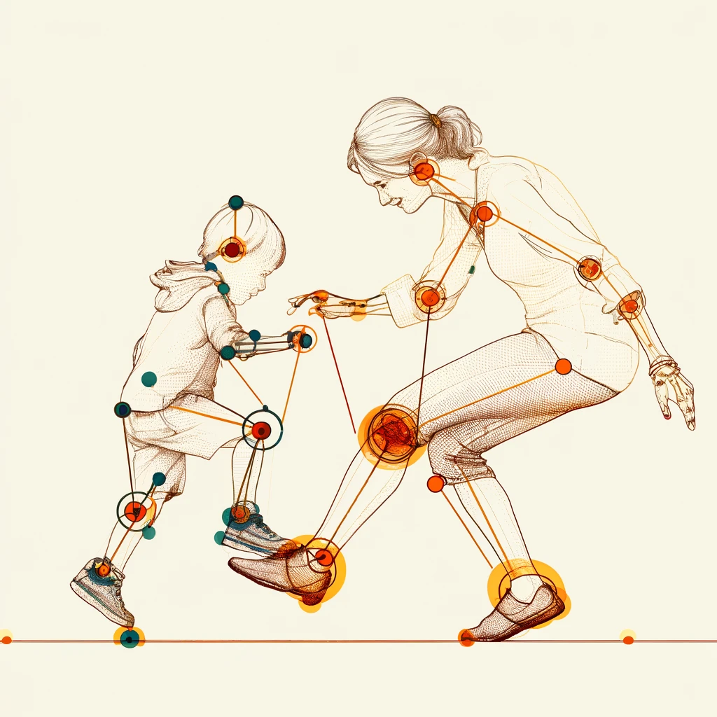

Evaluation of Interpersonal Synchronization between Individuals based on Video Recording P. 24-1-R-17
Final Project presentation Stage B
Project Advisor: Dr. Anat Dahan
Dana Betesh 315015958
Semion Rodman 319636395

Slide 2

Interpersonal Synchrony
Coordination of behaviors, emotions, physiological responses between individuals
Essential for social bonding, effective communication
Valuable for understanding the coordination of behavioral and physiological rhythms between individuals
People walking in sync: Example of spontaneous Interpersonal Synchrony
Notes:
Interpersonal synchrony – the tendency for social partners to temporally co-ordinate their behavior when interacting. Can be a product of conscious effort, such as when we shake hands, high five, or dance together. It may also arise spontaneously
Individuals with a temporary achieved strong level of IS, have been shown to synchronize their breathing, heart rate, and other behaviors
Examples: Pairs of individuals in rocking chairs tend to align their rocks to each other; conversation partners match their gestures, expressions, and language in time while communicating; and mothers and infants synchronize their heart rates during social exchanges.
Not a new topic of research – first described in 1912 in works of British sociologist Emile Durkheim
Renewed interest in late 2000s
Observers
Mechanical tests to quantify the measurements
Currently – video!

Slide 3
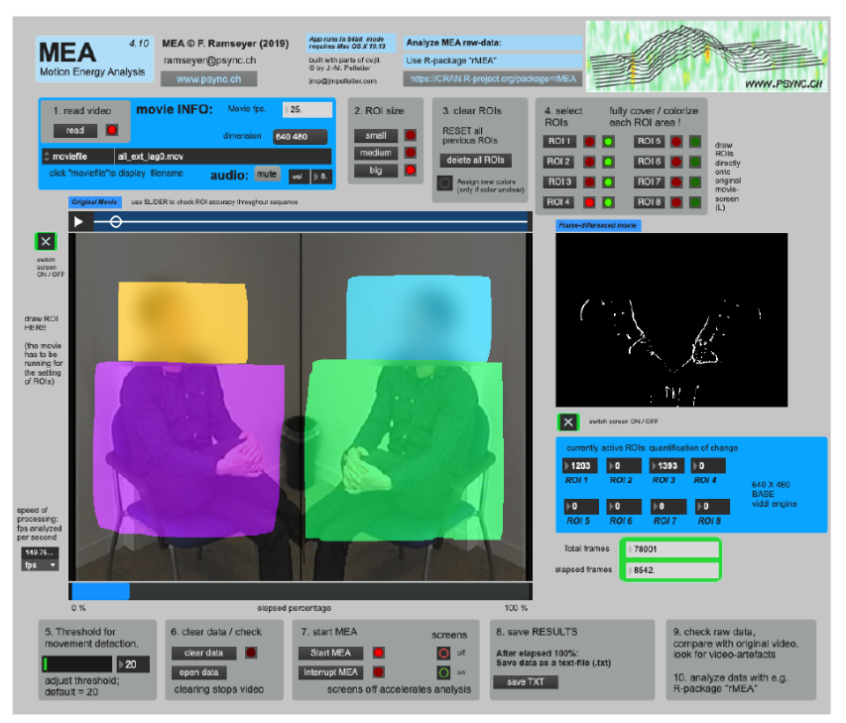
Challenges in current measurement methods
MEA (Motion Energy Analysis) frame-differencing algorithm that measures the differences between consecutive frames in a video recording by measuring the change in pixel values in a designated area
MEA detects all changes; some might not be a movement – false detection issue
2D recordings limit depth and accuracy
Overlapping actions obscure individual movements
Ramseyer, F. T. (2020). Motion energy analysis (MEA): A primer on the assessment of motion from video. Journal of counseling psychology, 67(4), 536
Notes:
Current solution

Slide 4
Requirements for a new solution
Accurate pose detection in dynamic settings, to ensure the captured data reflects true motion dynamics – for reliable analysis
Handling partial overlaps – reconstruction of movement for hidden or partially visible body parts. Needed to ensure tracking of movements when subjects interact closely or obstruct each other
User-friendly tool for a wide user-base
Notes:
Problem overview – why and what we need

Slide 5
Our solution – InterSync project
Use of video recordings for data collection
Machine learning for pose landmark detection, making use of the recent advancements in the field
Analysis based on the similarity of motion vectors instead of a pixel-based, frame-by-frame method
Flexibility in analysis tools – adapting to the data
Reports, plots, and lots of data giving user the ability to analyze independently
Notes:
Our objectives

Slide 6
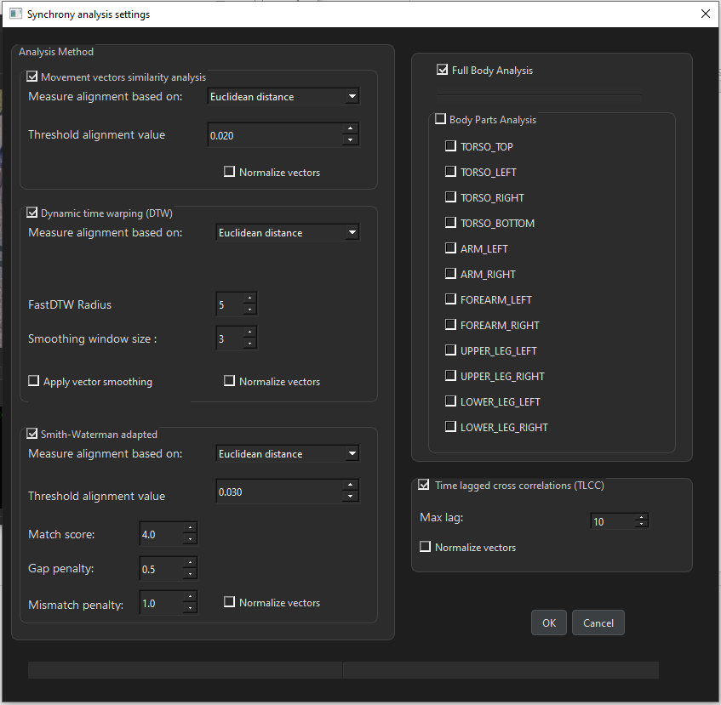
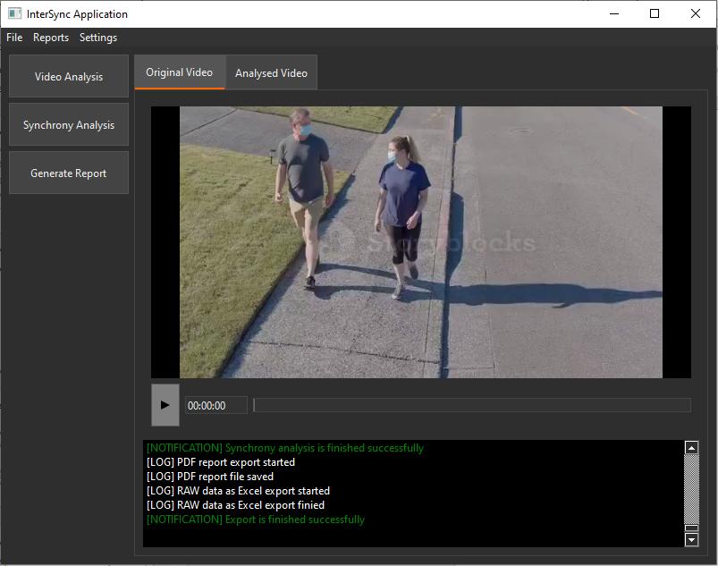
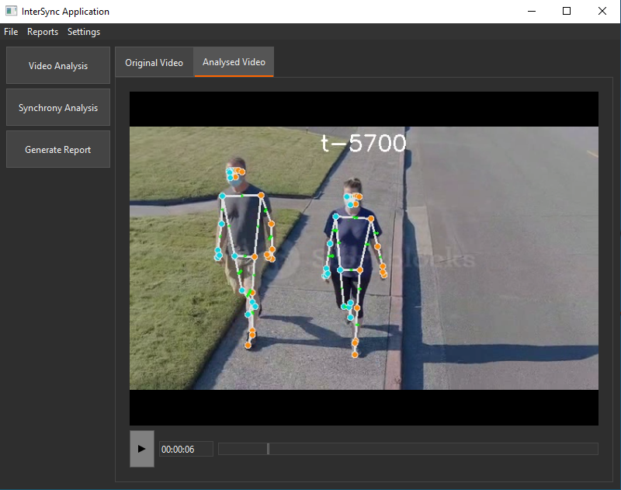
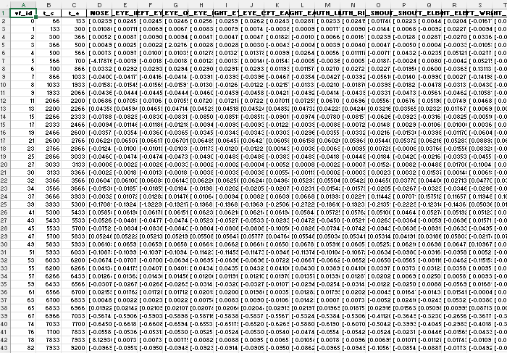
Our solution - preview
Notes:
Preview

Slide 7
Development process overview
Videos processing and analysis
Frame extraction – Keyframes or full frames
Landmark detection – including both targets
Movement vectors calculated
Calculation of vectors in the image frame-of-reference
Calculation of new axis based on each target
Vector transformations
Data summary
Analysis
Reporting
Examples of the videos analyzed by us
Notes:
Each of the following bullet-points posed a unique challenge from the development standpoint for us
Each had its tools, and in the final project each is represented by a separate package in the project

Slide 8
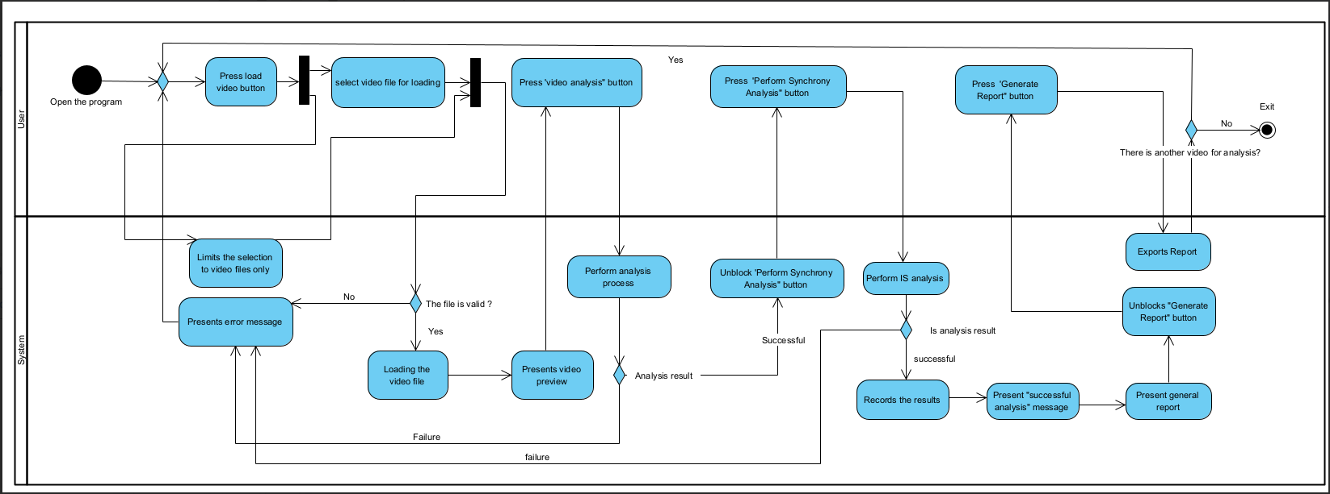
User Interaction – Activity Diagram

Slide 9
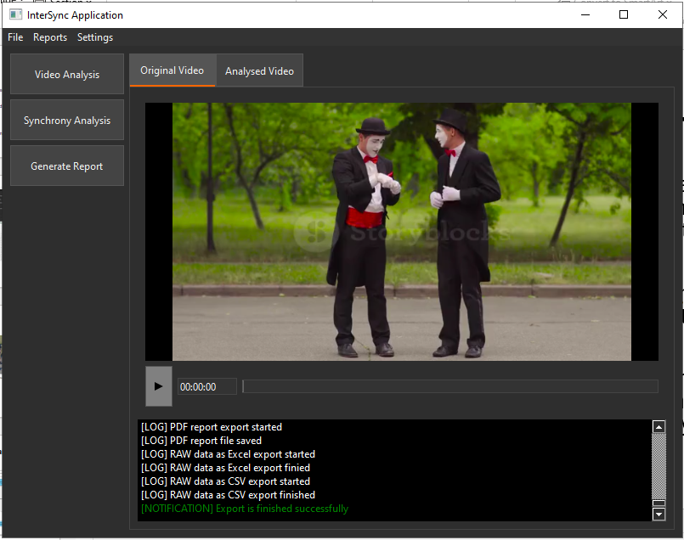
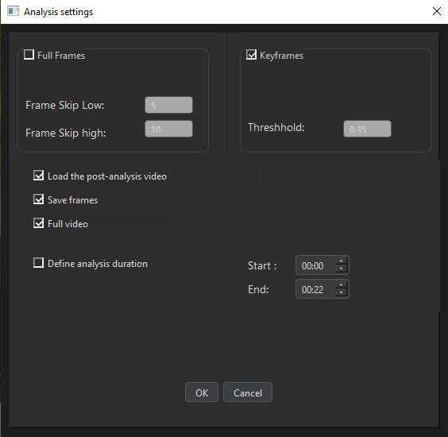
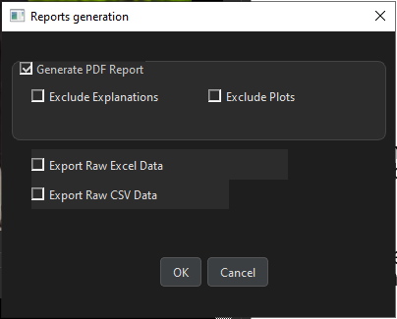
Client Interface - GUI
Was planned and created for target audience that may not have technical expertise in programming or computer vision
Designed through a number of iterations to be as accessible and intuitive as possible
Built using PyQt6 and enables users to interact with the system through simple actions – represented by visual elements
GUI, or at least some parts of it.
We could not fit more here
Notes:
Our objectives

Slide 10
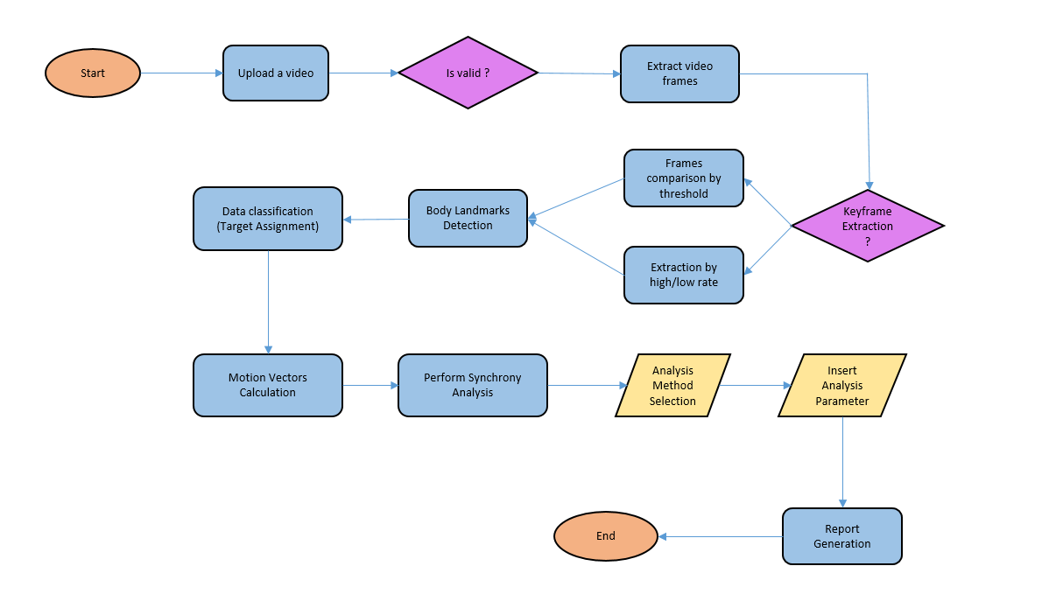
General algorithm overview
Finding and extracting key frames from the video
Detection of body landmark locations
Calculation of vectors from movement keyframes
Building vector representations of body movement
Measuring IS using several algorithms

Slide 11
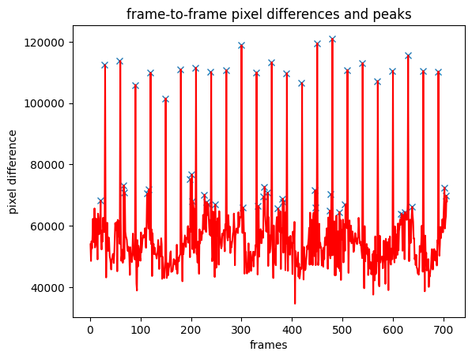
Video Processing - Keyframes
Keyframes - frames that marks significant changes within a video sequence.
Video is processed frame-by-frame using OpenCV library
Extracted frames are being compared to detect major changes in the pixel values that are indicative of major changes in the image itself
Values are plotted and a user-defined threshold value is applied using a PeakUtils library.
Frames that correspond to the threshold-crossing peaks defined as “Key Frames”
Example of the data plotted to show the pixel value difference between frames. Marked by ‘x’ mark are the peaks corresponding to the frames being selected for future processing. The threshold value used is 0.35
Notes:
Keyframes – initial idea

Slide 12
Video Processing – “Full frames”
Additional option introduced for building a set of frames
Frame selection with skips - covers cases where the dynamics of the scene makes the keyframe detection process unreliable
dynamic background
movements that do not translate into discrete segments
User provides a value that is being used as a counter for skipping frames
Notes:
Additional option introduced in our system for building a set of frames to base the analysis on - “frame selection with skips” intended to cover cases where the dynamics of the scene makes the keyframe detection process unreliable for multiple reasons, such as dynamic background, consistent movements that do not translate into discrete segments that can be detected, etc.
When using this option the user provides an integer value that is being used as a counter for skipping frames, to ensure the analysis is done on a manageable amount of sufficiently different data.
For example, for the value provided ‘10’ - each 10th frame is selected for the analysis, disregarding the frame contents and suitability

Slide 13
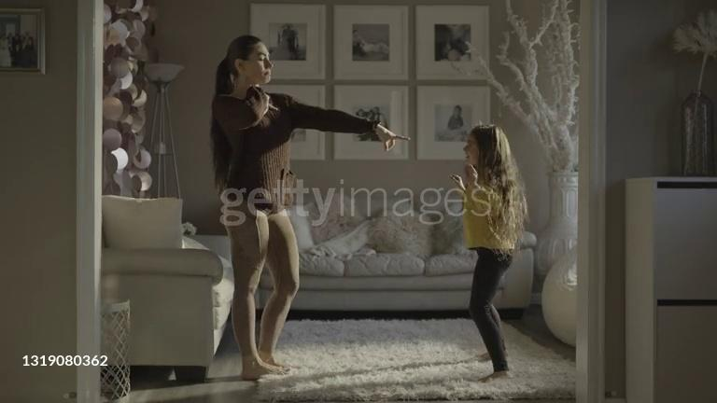
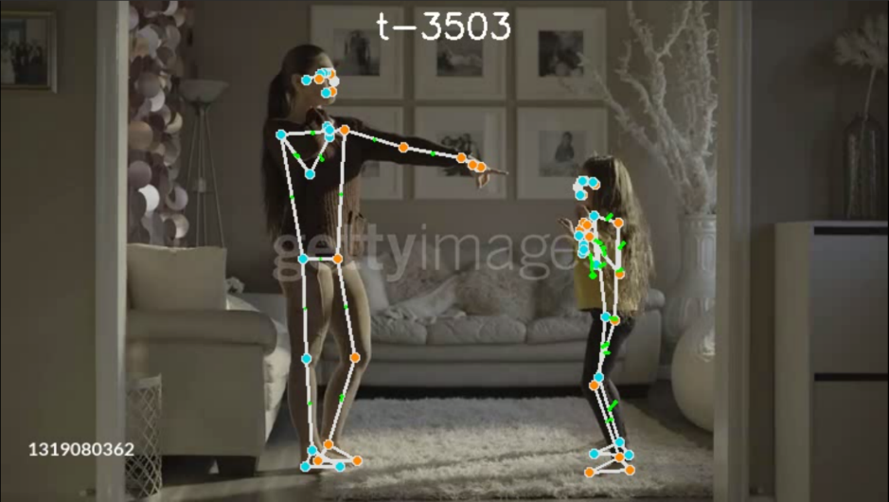
Video Analysis – Landmark detection
Frame data is being run through the MediaPipe Landmark Detection task, to holistically detect the landmarks
The task uses a convolutional neural network similar to MobileNetV2 optimized for on-device, real-time applications
A variant of the BlazePose model uses a human shape modeling pipeline, to estimate the full 3D body pose of an individuals in images
Frame with detection results of both targets overlaid on it
(The pretty lines? We added them! Usually it’s just coords)
Notes:
Open-source software project by Google
Real-time, accurate pose estimation using ML, with detection of up to 32 key points on the human body in 3D ( x, y, z coordinates)

Slide 14
Video Analysis – Data/Target classification
For each frame, the system records a dataset of 33 detection points found
The system is tasked with locating which target the data is related to
Target center calculation – by finding the center between the subjects’ shoulder points
Comparing the Euclidean distance between the previous and a new, calculated center, and assigning the datasets to the Targets accordingly

Slide 15
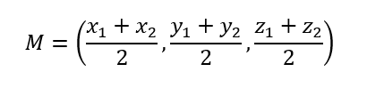
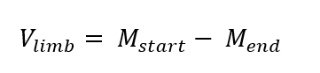
Calculation of Movement Vectors
The limb is defined using landmarks that represent the start and the end point of each limb
The average of the coordinates of the two landmarks represents the midpoint of the limb
Limb movement vectors are determined by calculating the difference between the midpoints of the end frame and the start frame.
Represents the motion of the limb from the start to the end of the frame
Still operating in the original image coordinates
For a pair of landmarks (lm1,lm2) with coordinates (x1,y1,z1 ) and (x2,y2,z2 ) the limb midpoint M is calculated as
For a limb midpoint in the start frame (M start) and in the end frame (M end) the movement vector V limb is given by

Slide 16
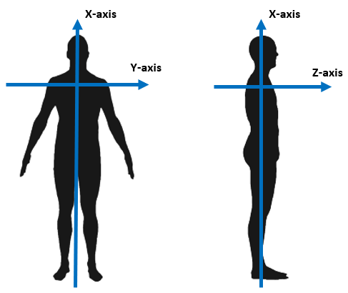
New Basis Vector Calculation and Motion Vector Transformation
We are interested in the motion of the detection Target itself and as such we update the coordinate system to match our needs for the future analysis
Transformation of the coordinate system from image-based coordinates to a target-based coordinates
Representation of new Target-relative coordinates system

Slide 17
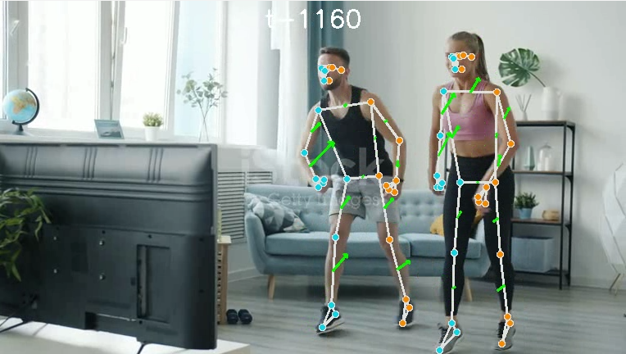
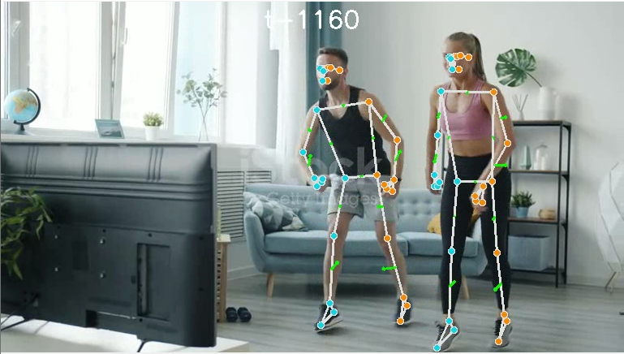
New Basis Vector Calculation and Motion Vector Transformation
Movement in the image-based coordinates
Movement in the Target-based coordinates, notice the difference in leg movements

Slide 18
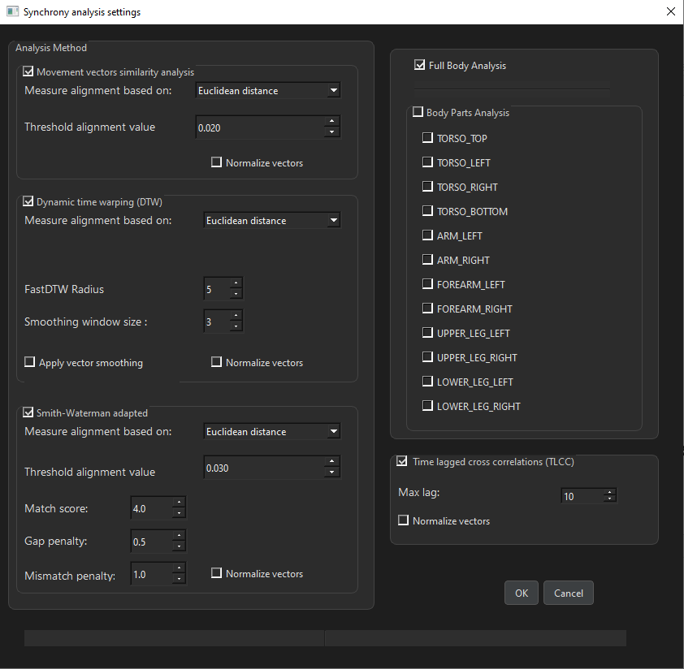
Interpersonal Synchrony Analysis
Methods implemented as part of our project:
Basic Similarity Analysis – vector matching
Time-Lagged-Cross-Correlation (TLCC)
Dynamic Time Warping (DTW)
Smith-Waterman local sequence alignment
No unified set of analysis parameters that perfectly suits all the videos
User can select tools and parameters that produce the best result for given data
Analysis menu with the user options present – a lot of options!

Slide 19
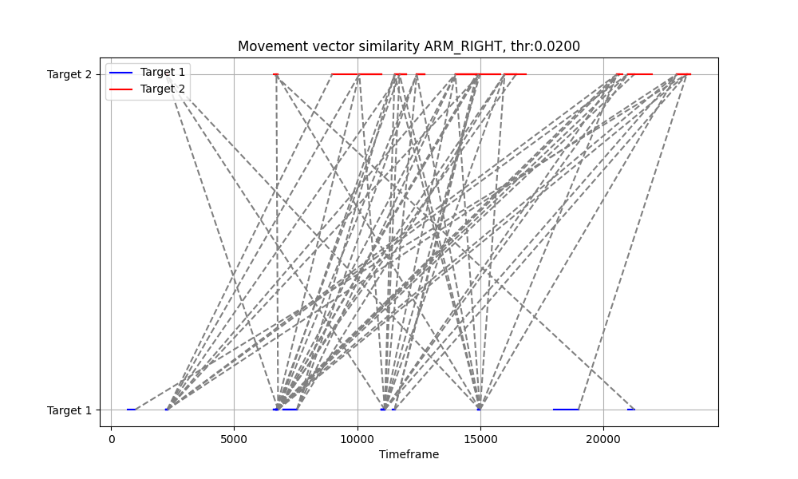
Basic Similarity Analysis
Compares individual segments of movement data between two subjects
Identifies timeframes where their movements are most similar
Cosine or Euclidean distance to measure the similarity
Match - if the similarity is within a user-defined threshold
example of the Basic Similarity Analysis plot done for right arm, Euclidean distance with threshold of 0.02

Slide 20
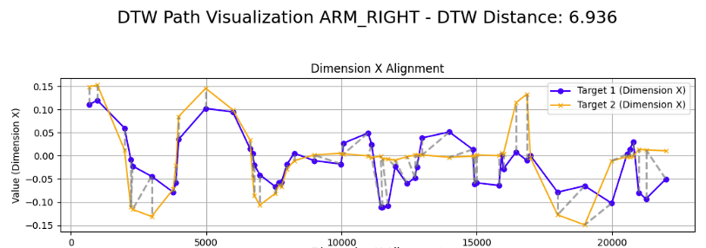
Dynamic Time Warping (DTW)
Aligning the data to minimize the distance between corresponding segments
Best for comparing sequences of movement that may be similar in shape
We are using a FastDTW algorithm adaptation for easier and faster calculation
Example of DTW alignment visualization for right arm, separate for X axis, DTW distance of 6.93
Idealized explanation of what DTW is trying to achieve, taken from https://rtavenar.github.io/blog/dtw.html

Slide 21
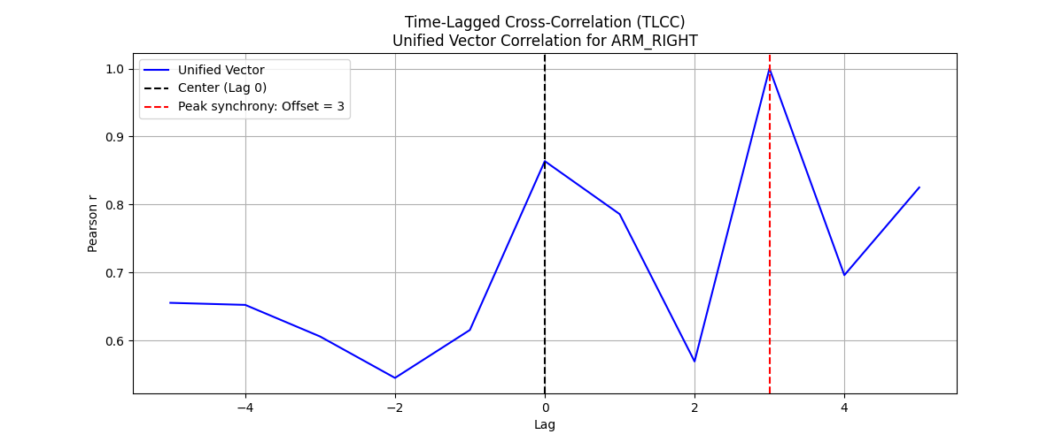
Time-Lagged Cross-Correlation (TLCC)
Correlation of time-shifted data streams
Effective for identifying synchrony with slight temporal misalignments
Results in a correlation score
Example result plot of TLCC analysis with peak synchrony calculated at a lag of 3 movements
Animated example of TLCC, for better understanding

Slide 22
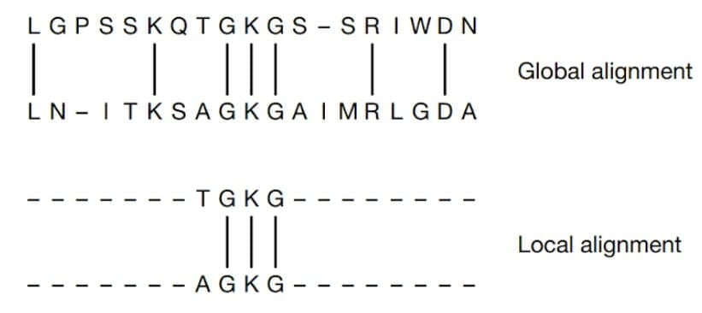
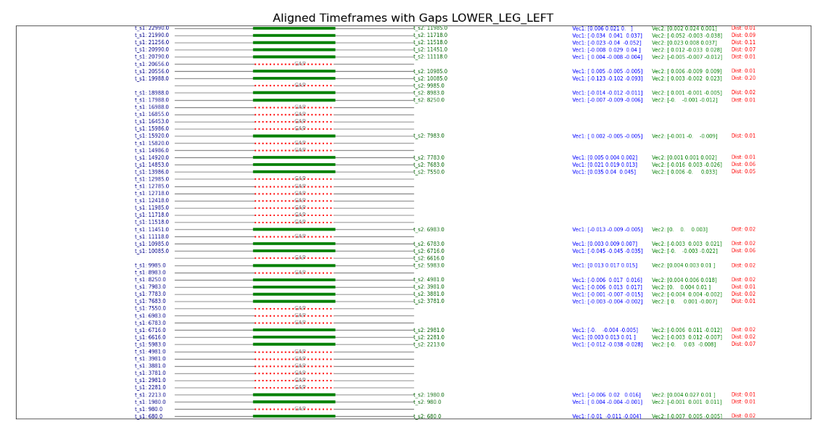
Smith-Waterman algorithm
Dynamic programming algorithm used in bioinformatics for local sequence alignment of DNA sequences
Adapted to compare movement sequences between two movement data sets
Highlights specific moments of synchrony, even if the entire movement sequence is not synchronized!
Example of Global and Local Alignment of two nucleotide sequences – original usage of Smith-Waterman
Example of Smith-Waterman analysis – with green lines representing the alignment of movements across two targets.

Slide 23
Smith-Waterman algorithm
As far as our search goes, we seem to be the first ones to try and adapt this algorithm specifically to interpersonal synchrony
Small number of research articles (2!) we found online that touch on Smith-Waterman being used as part of a any motion analysis process
Algorithm allows for flexibility in the similarity metric used, with options for Euclidean distance and Cosine similarity
Thresholds for determining similarity can be fine-tuned, ensuring that the algorithm detects meaningful synchrony rather than noise.

Slide 24
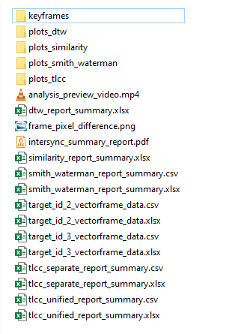
Outputs and Results
Project generates comprehensive outputs that enable detailed examination of synchronization between two subjects
Provides an overall run report
Functionality of exporting data summaries and visualizations – PDF, Excel, CSV
Clear, interpretable results
Files generated as part of data export

Slide 25
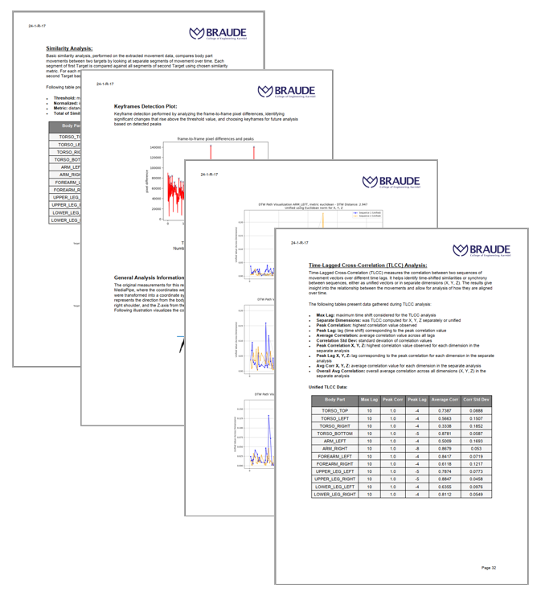
Outputs and Results
Video analysis result
For each analysis – we provide the summary both as part of the overall PDF and as a separate file
Raw motion vector data for the detection targets
Excel or CSV – for user convenience
Pages from the PDF run report (there are a lot of pages, much more than 4)

Slide 26
Result Validation
We used a collection of videos gathered from the Stock Videos sites online
Following characteristics:
Two detection targets
Motion present
Resolution of 768 x 432 or better
Manually compared the videos with the detection results to verify the correctness of the detection methods
Additional value to be found in a verification process done as part of a larger study

Slide 27
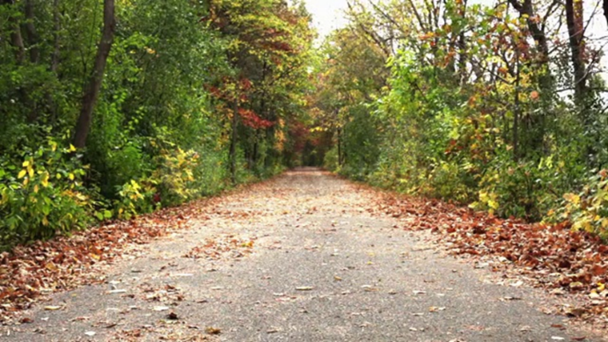
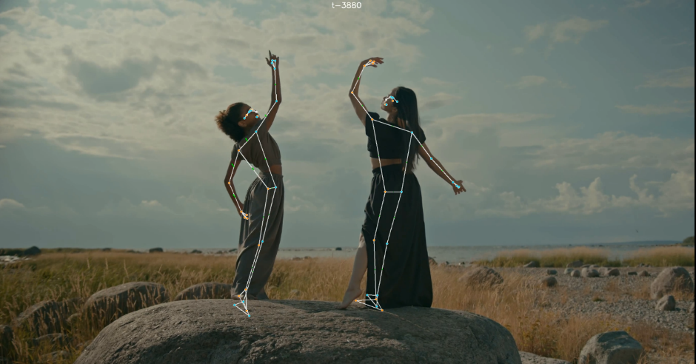
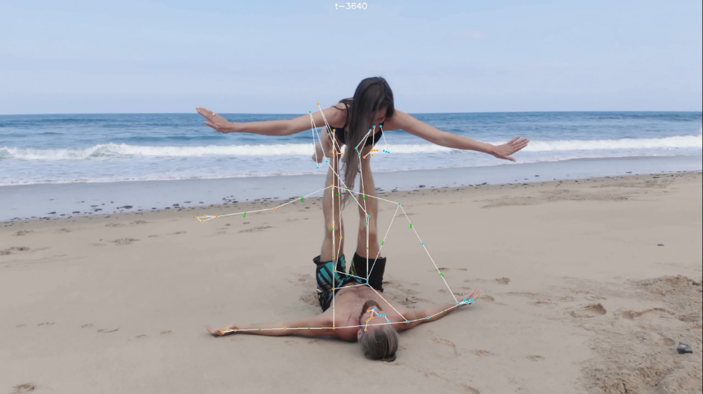
Limitations and Challenges
Example of a wrongly identified ‘Keyframe’ due to the movement of foliage
Dynamic backgrounds
Video quality
Skipped frames and detection failures
Reliance on the resources of the PC
Identifying and associating targets
Example of clothing interfering with the detection process
Example of identification issue when subjects are in highly unorthodox positions

Slide 28
Future Work and Improvements
Improved Video Handling:
Background filtering to reduce noise and handle complex scenes
Better noise reduction for low-quality videos
Improved Efficiency:
Parallel processing for faster analysis
Algorithm optimization to reduce computational needs
Improved Target Tracking
Improved accuracy of landmark assignment using additional computer vision and calculation-based techniques
Better handling of occlusions and subject tracking

Slide 29
Conclusions
We created a robust system for detecting and analyzing IS using computer vision
Achieved detailed, body part-specific synchrony measurement
Incorporated multiple algorithms for flexible analysis
Generates comprehensive reports in PDF, Excel, and CSV formats for easy review
System performance depends on video quality and has computational challenges
Notes:
Our objectives

Slide 30
Thanks!
Thanks!
Also – Q&A time

